Slide 1
Comp 4350 Software Engineering II Lecture 8
Dr. Shaowei Wang

Slide 2

Review of testing

Slide 3
Development testing
Unit testing
Target: particular program unit (class/method)
Focuses on testing the functionality of an object or a method
Integrating testing
Target: the combination of units that make up a component
Focuses on the interface (e.g., parameters, message passing) that a component exposes to other components
System testing
Target: the whole system
Focuses on the functional and non-functional requirements (e.g., performance, usability)

Slide 4
Regression testing
A software testing practice that ensures an application still functions as expected after any code changes, updates, or improvements.
Goal
Make sure the changes in code does not break existing functional and non-functional requirement of the system.
Find defect in early stage.

Slide 5

Who tests the tests?
How can we measure test cases?

Slide 6
Outline
Test coverage
Applications for testing coverage
Mutation testing

Slide 7


Measure the test cases
Read P
Read Q
IF P+Q > 10 THEN
Print “Large”
ENDIF
If P > 50 THEN
\\ bug is here
…
ENDIF
Test suite A
Test case 1 P= 5, Q=10
Test suite B
Test case 1 P =5, Q=10
Test case 2 P =51, Q=4

Slide 8
Two types of coverage in test coverage
Covering code (white box)
Covering input space (black box)
Notes:
Such coverage metrics quantify the coverage of test cases, and also drive the design of test cases.

Slide 9
Covering code (for white box testing)
How much code is covered by test cases?
The testing has to reach a targeted coverage of statements/branches/paths; the objective can be to:
cover all possible statements
cover all possible branches
cover all possible (99%) paths

Slide 10
How to measure the coverage?
1) run test case, collect the execution information, e.g., which statements are executed?
2) program analysis – how many branches/paths in the program in theory?
3) calculate the coverage

Slide 11
Void Main(){
…
O.Func1();
O.Func2();
…
}
Void Main(){
…
O.Func1();
log.info(“O.Func1 is executed”);
O.Func2();
log.info(“O.Func2 is executed”);
…
}
instrumentation

Slide 12
Collecting execution info - instrumentation
Instrument at compile time
e.g., logging, AspectJ
Instrument or monitor at runtime
Also requires a special VM
E.gVisualVM (hooks into JVM using debug symbols to profile/monitor)

Slide 13
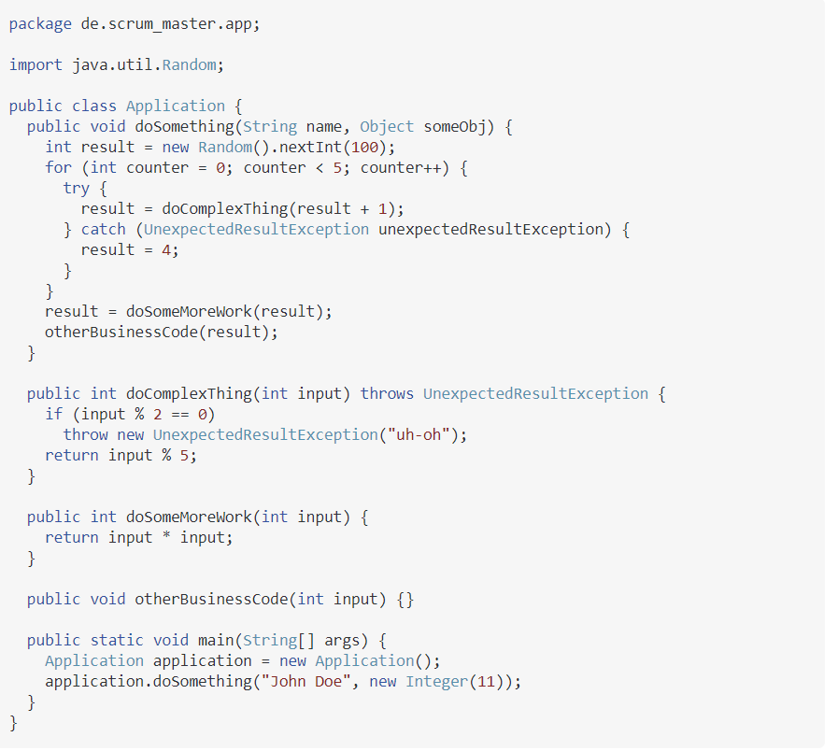


Slide 14
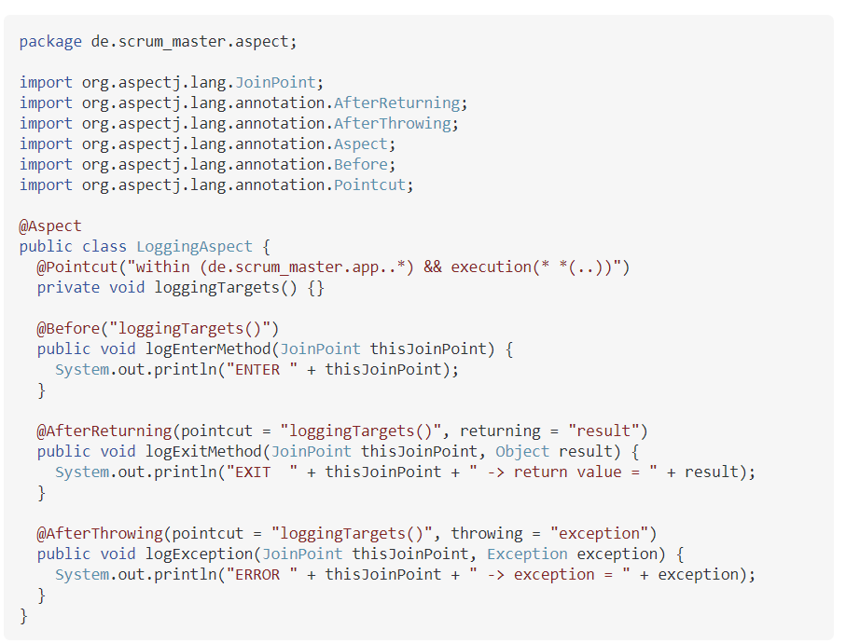
https://www.javatpoint.com/spring-aop-aspectj-annotation-example

Slide 15
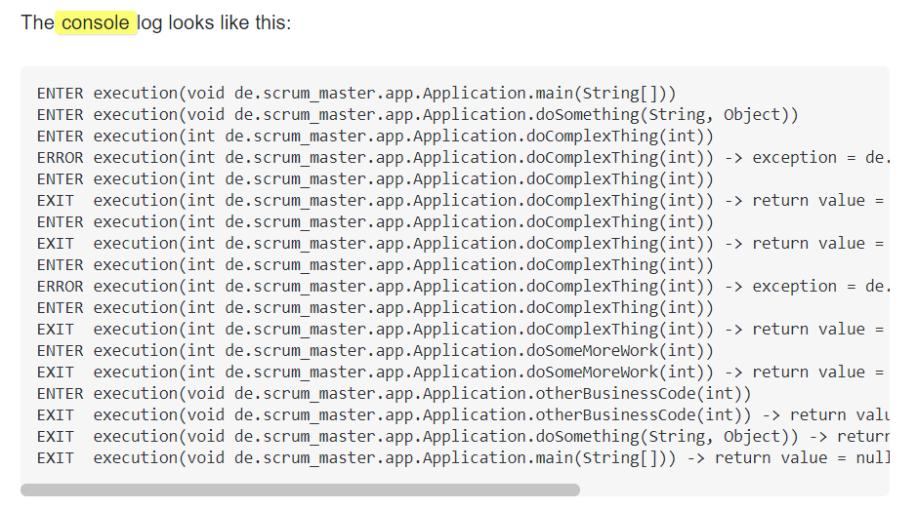
https://stackoverflow.com/questions/48470588/placing-log-information-inside-a-method-using-aspectj-spring

Slide 16
Collecting execution info - instrumentation
Instrument at compile time
e.g., logging, AspectJ
Instrument or monitor at runtime
Also requires a special VM
E.g, Javassist, VisualVM (hooks into JVM using debug symbols to profile/monitor)

Slide 17
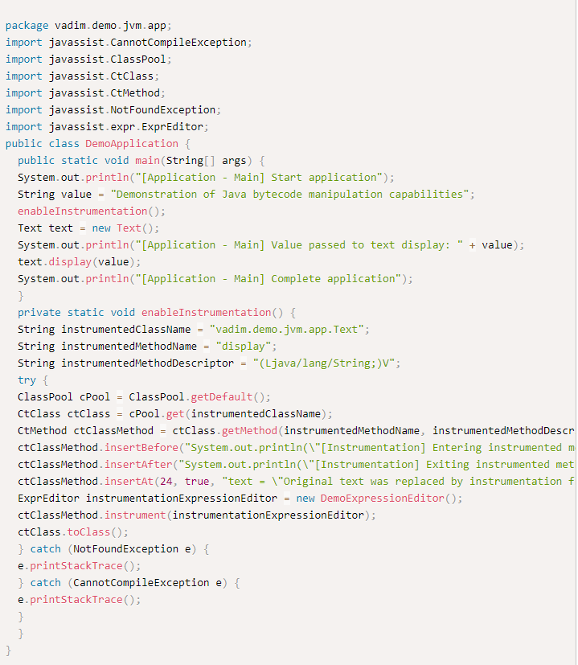
Java Bytecode Instrumentation
We know that when we run our Java programs it gets converted to bytecode.
These are then loaded to JVM using classloaders.
Bytecode instrumentation use Instrumentation APIs (Javassist) to modify the bytecodes of these programs at runtime.

Slide 18
How to measure the coverage?
1) collect the execution information, e.g., which statements/branches are executed?
2) program analysis – how many statements/branches in the program?
3) calculate the coverage

Slide 19

Control flow graph
In computer science, a control-flow graph (CFG) is a representation, using graph notation, of all paths that might be traversed through a program during its execution.
Entry
Exit
Control node: Each branch in the code (such as if and while statements) creates a branch in the graph
Basic block: a straight-line code sequence with no branches in except to the entry and no branches out except at the exit.
https://www.geeksforgeeks.org/software-engineering-control-flow-graph-cfg/

Slide 20
Read P
Read Q
IF P+Q > 10 THEN
Print “Large”
ENDIF
If P > 50 THEN
Print “P Large”
ENDIF

Slide 21

Cover all possible statements?
Input: P=60, Q=10
Read P
Read Q
IF P+Q > 10 THEN
Print “Large”
ENDIF
If P > 50 THEN
Print “P Large”
ENDIF
1A-2C-3D-E-4G-5H
Notes:
1A-2C-3D-E-4G-5H

Slide 22

Cover all possible branches?
Read P
Read Q
IF P+Q > 10 THEN
Print “Large”
ENDIF
If P > 50 THEN
Print “P Large”
ENDIF
1A-2C-3D-E-4G-5H
1A-2B-E-4F
Input: P=60, Q=10
Input: P=1,Q=1
Notes:
1A-2C-3D-E-4G-5H
1A-2B-E-4F

Slide 23
Cover all possible paths?
Read P
Read Q
IF P+Q > 10 THEN
Print “Large”
ENDIF
If P > 50 THEN
Print “P Large”
ENDIF
1A-2B-E-4F
1A-2B-E-4G-5H
1A-2C-3D-E-4G-5H
1A-2C-3D-E-4F
Notes:
Path coverage is very difficult

Slide 24

Exercise: generate the test case input to cover all paths?
Input: P=1,Q=1
Input: P=60, Q=-60
Input: P=60, Q=10
Input: P=6; Q=6

Slide 25
Question: How many paths?
...
for (int i = 0; i < n; ++i) {
if (a.get(i) == b.get(i))
x[i] = x[i] + 100;
else
x[i] = x[i]/2;
}
...
Notes:
What does this mean?
Pair and share exercise
Looking for “No absolute certainty can be gained by testing”

Slide 26

The ugly truth about testing: Large number of possible paths
If each test takes 10⁻³ seconds, with n=36, we need more time than has passed since the big bang!
...
for (int i = 0; i < n; ++i) {
if (a.get(i) == b.get(i))
x[i] = x[i] + 100;
else
x[i] = x[i]/2;
}
...
Number of Paths = 2^{n}
n | Number of paths
1 | 2
2 | 4
3 | 8
10 | 1024
20 | 1048576
60 | 1.15 x 10¹⁸
Notes:
What does this mean?
Pair and share exercise
Looking for “No absolute certainty can be gained by testing”

Slide 27
How to measure coverage?
In practice, we measure statement (line) coverage
# of statements (line) being executed/ # total statements
Input: P=60, Q=10

Slide 28
Exercise – calculate the statement coverage
Read P
Read Q
IF P+Q > 10 THEN
Print “Large”
ELSE
Print “Small”
ENDIF
If P > 50 THEN
Print “P Large”
ENDIF
Print “Small”
Input: P=60, Q=10

Slide 29

Exercise – calculate the statement coverage
Read P
Read Q
IF P+Q > 10 THEN
Print “Large”
ELSE
Print “Small”
ENDIF
If P > 50 THEN
Print “P Large”
ENDIF
Print “Small”
Input: P=60, Q=10

Slide 30
Code coverage tools (for Java)
JaCoCo – free code coverage tool (current version of Cassandra, etc.)
Coverage.py – Coverage.py is a tool for measuring code coverage of Python programs.
Cobertura – not actively maintained any more, used in earlier version of Cassandra
Emma – not actively maintained any more, and don’t support the current Java version
etc.

Slide 31
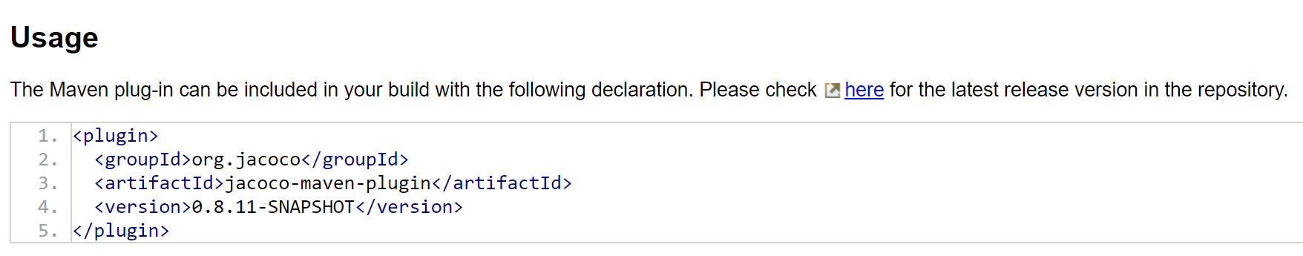
Know about JaCoCo - Features
Free code coverage tool for Java, developed as a replacement for EMMA
Coverage analysis of branches, lines, methods, and cyclomatic complexity
Several report formats (HTML, XML, CSV)
Integration with Various Tools (Ant Tasks, Maven plug-in, Gradle)

Slide 32
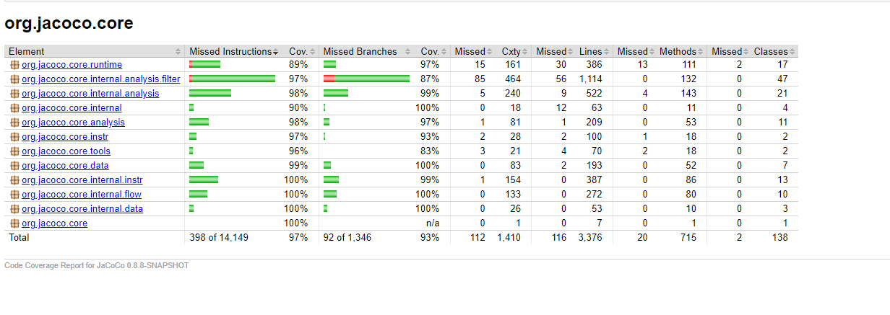
https://www.jacoco.org/jacoco/trunk/coverage/org.jacoco.core/index.html

Slide 33
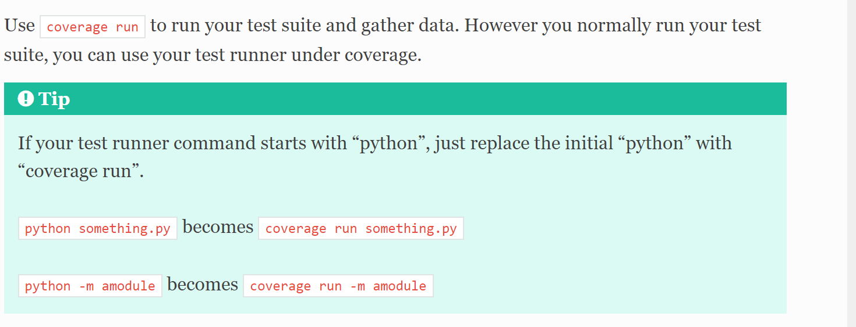
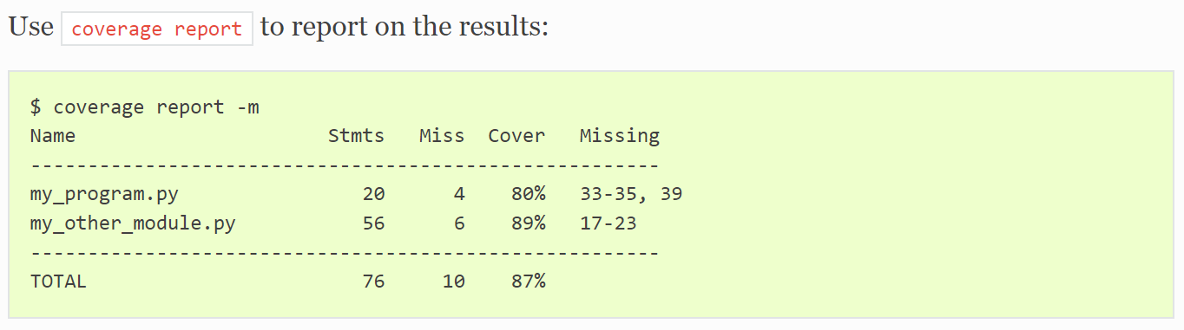
Coverage.py

Slide 34

Overhead for instrumentation
Affect performance

Slide 35
We will cover two types of coverage
Covering code (white box)
Covering input space (black box)

Slide 36
Covering input space (for black-box testing)
Input domain for testing is infinite.
E.g., real number in [1,1000]
Testing is fundamentally about choosing finite sets of values (i.e., a representative set of inputs) from the input domain.

Slide 37
Unit testing strategies
Equivalence classes:
Identify groups of inputs that have common characteristics (should be processed the same way)
Such groups are called equivalence classes.
A tester needs only to run one test per equivalence class

Slide 38
Examples of equivalence classes
Valid input is a month number (1-12)
Equivalence classes are: [-∞..0], [1..12], [13.. ∞]
Valid input is one of ten strings representing a type of fuel
Equivalence classes are
10 classes, one for each string
A class representing all other strings
Don’t forget Null/empty
File upload with different size (up to 1G):
Equivalence classes are
Small file uploads (less than 1MB).
Medium-sized file uploads (1MB to 100MB).
Large file uploads (100MB to 1G).
Over size (> 1G)
Notes:
Identify equivalence class using specification and documentation, or experience
Natural gas, fossil fuel etc

Slide 39
Rule of thumb
Boundary testing: This involves testing input values that are close to the minimum or maximum values that the system can handle. This can help you find errors or unexpected behavior near the boundaries of the input range.
Negative testing: This involves providing input that is known to be incorrect or outside the expected range, and testing that the system behaves appropriately, such as by rejecting the input or providing a useful error message.
Input validation testing: This involves testing the input validation logic in your system to ensure that it properly rejects invalid input and handles input errors. (e.g., password formatting error)

Slide 40
Application
Application based on code coverage:
Spectrum-based fault localization

Slide 41

Fault Localization
Problem: Given a set of test cases, one or several test cases fail, where are the buggy lines?
Test suite
System
where are the bugs?

Slide 42
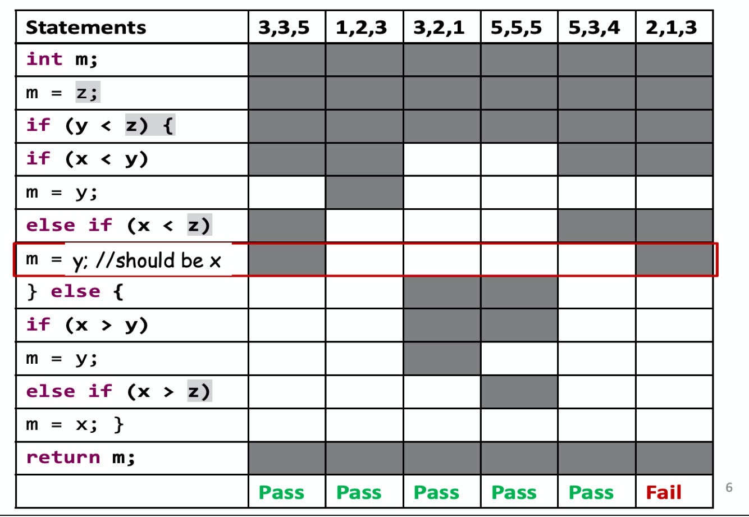
Fault Localization
Problem: Given a set of test cases, one or several test cases fail, where are the buggy lines?
int mid (x, y, z) {
Test cases
}

Slide 43
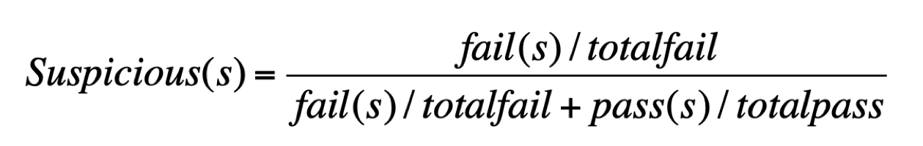
Coverage-based Fault localization
Intuition: Statements that are primarily executed by failed test cases are more likely to be faulty than those that are primarily executed by passed test cases
Solution: Ranking based on suspiciousness (Tarantula)
number of failing test cases is executed by s
S: statement
number of passing test cases is executed by s

Slide 44
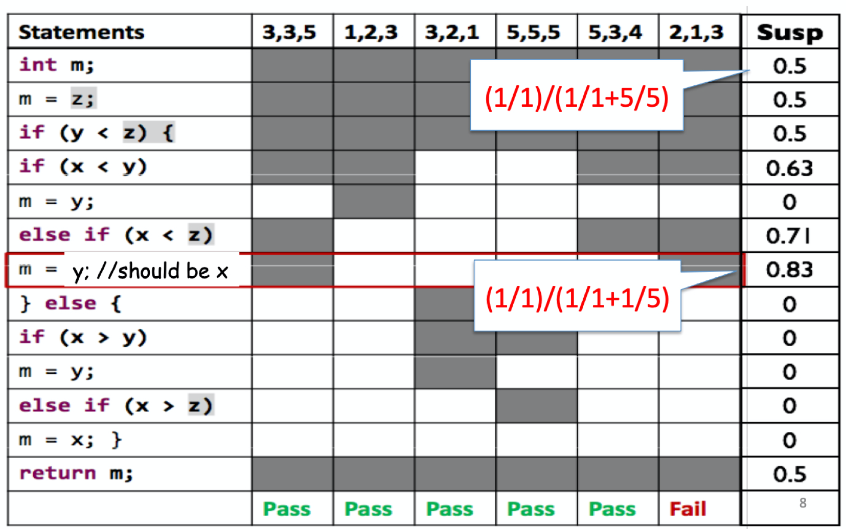
An Example of Using Tarantula
Running on all the pass cases.
Only running on 1/5 of the pass cases.
Notes:
Tarantula: https://github.com/prove/tarantula
Tarantula is modern tool for managing software testing in agile software projects. It's free, licensed as open source software under GNU GPLv3.
www.testiatarantula.com

Slide 45
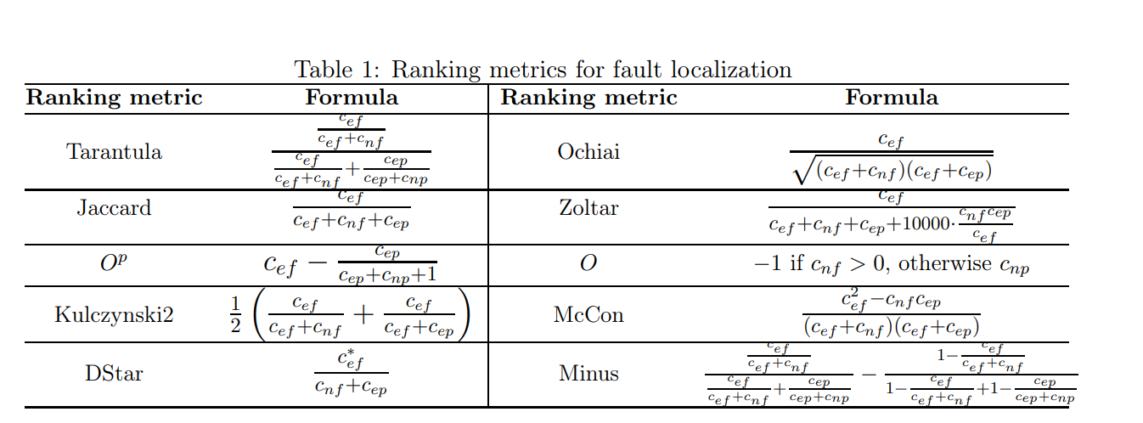
Other ranking formulars
c_{ef} indicates the number of failing test cases (f) is executed by a program entity (c), c_{nf} is the number of failing test cases is not executed (n) by a program entity
Totalfail = c_{ef +} c_{nf}
c_{ep} is the number of passing test cases (p) is executed by a program entity and c_{np} represents the number of passing test case is not executed by a program entity
Total pass = c_{ep +} c_{np}

Slide 46



Exercise
c_{ef} indicates the number of failing test cases (f) is executed by a program entity (c), c_{nf} is the number of failing test cases is not executed (n) by a program entity, c_{ep} is the number of passing test cases (p) is executed by a program entity

Slide 47
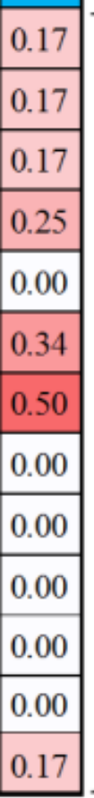
Exercise
c_{ef} indicates the number of failing test cases (f) is executed by a program entity (c), c_{nf} is the number of failing test cases is not executed (n) by a program entity, c_{ep} is the number of passing test cases (p) is executed by a program entity

Slide 48
Materials
https://www.synopsys.com/content/dam/synopsys/sig-assets/whitepapers/what-is-fuzzing.pdf
https://www.fuzzingbook.org/
https://www.guru99.com/mutation-testing.html
https://www.softwaretestinghelp.com/what-is-mutation-testing/

